Slide 2
Activities
Filter Design
Component Selection (Choke, Capacitors)
Two mode Designing (both is AWR and Hardware simulation(PCB))
S parameter measurement
Identify filter responses (frequency and time)
Compare responses (both is software and Hardware simulation)
Identify filter responses using both single and multi tone sources
Generate noise sources (both in Hardware and AWR)
Simulate the filter with noise source (both in AWR and Lab)

Slide 3
Filter Design
EMI filter is designed to reduce high frequency electronic noise that cause interference with other devices where considering the conducted emission produced by the components inside.
We have designed the filter work like a low pass filter.
Transmission loss and Insertion loss was measured.

Slide 4
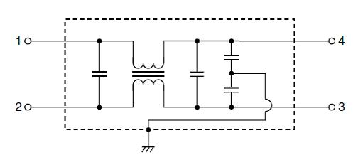
Component Selection (Choke, Capacitors)
Consists of passive components, including capacitors and inductors. A common mode choke is used instead of inductors which itself works like a filter.

Slide 5
Two mode Designing

Slide 6
S parameter measurement

Slide 7
Identify filter responses (frequency and time)

Slide 8
Compare responses

Slide 9
Identify filter responses using both single and multi tone sources

Slide 10
Generate noise sources and simulate with filter
A noise source is generated whose tone frequencies are, 12, 36, 60, 84,……MHz
The amplitude is measured in mV.
In AWR only 7 tones were taken (AWR allows max 8 tones).
The noise source is calibrated in AWR with the designed filter and the result was observed.
At the above frequencies all the output frequencies behaves like stop band.
But additionally I have designed a noise source whose tone frequencies were 120, 360, 600, 840…Khz. In the output of the filter, it is seen that only 120Khz is pass band. So I have understand that I have to change the capacitors so that pass band frequency increases.

Slide 12
